Slide 1
Pytroch Satellite image classification using networks
Wong Kai Yuan DC026157
Guan Jia Xi CC029721

Slide 2
TABLE OF CONTENTS
01
02
03
04
INTRODUCTION
GOAL
Pytorch, Dataset, Network model
Develop a model that can predict and classify satellite images
Implementation
Conclusion
MLP
DNN
Final result of testing

Slide 3
01
INTRODUCTION

Slide 4
Pytorch
PyTorch is an open source machine learning library primarily used for Deep Learning applications, computer vision and natural language processing using GPUs and CPUs.

Slide 5
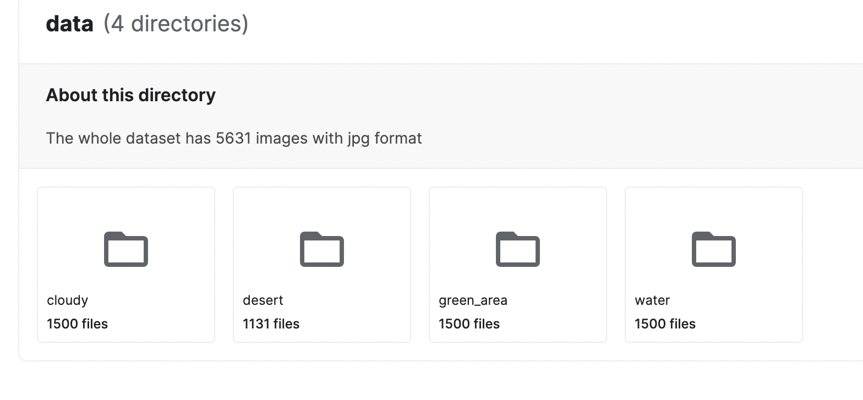
Dataset
Satellite image Dataset from Kaggle, contains four classes of satellite images which are: water, desert, cloudy and green area, with 5631 images in total and around 1500 images of each class.

Slide 6
Neural Network Model
In this project, MLP and DenseNet model will be used to classify the dataset

Slide 7
02
Goal
To develop a deep learning or neural network model that can predict or classify satellite images into four classes using pytorch.

Slide 8
03
Project Body

Slide 9
For each Implementation :
Introduce our model
Data Processing
Define Model
Train and evaluate the model
Final result on testing
More details in report

Slide 10

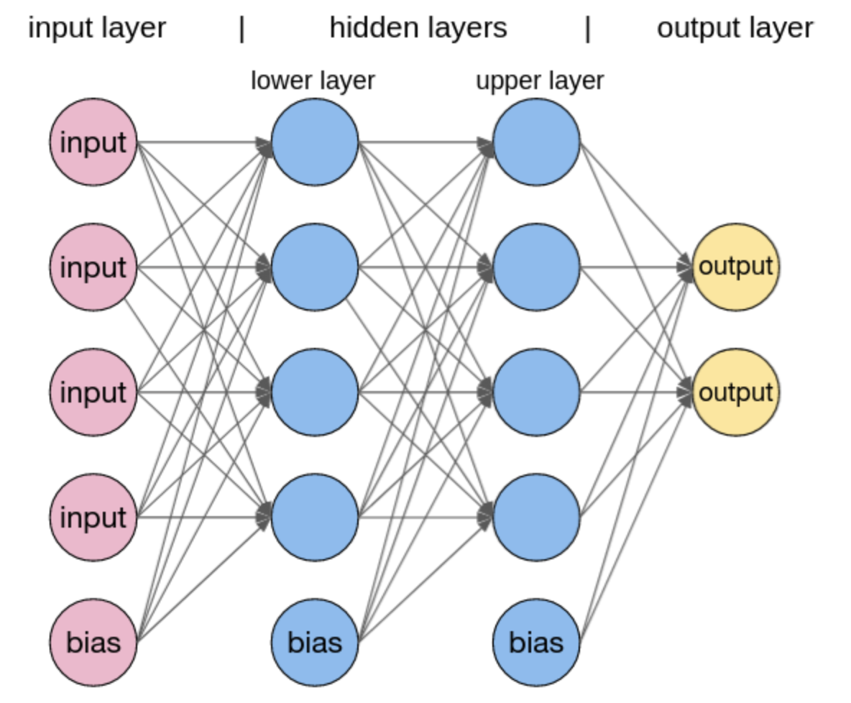
Implementation of
Multilayer Perceptron (MLP)
What is MLP ?
A multilayer perceptron is a fully connected class of feedforward artificial neural network. It is one of the most basic neural network architectures.

Slide 11
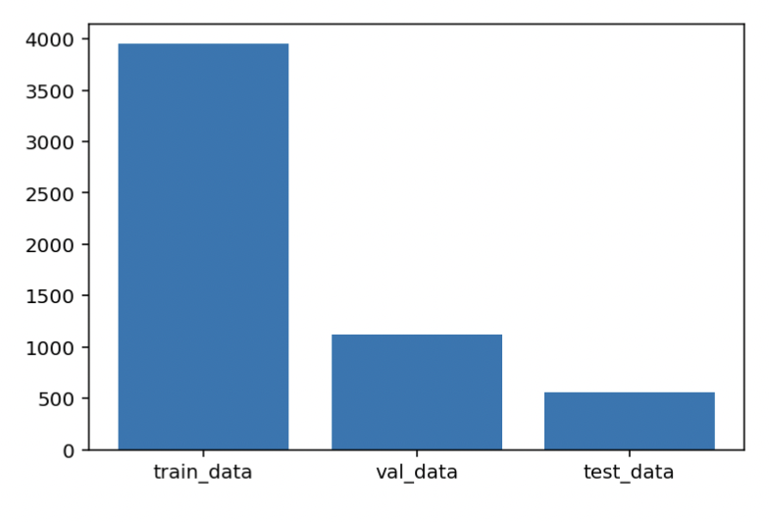
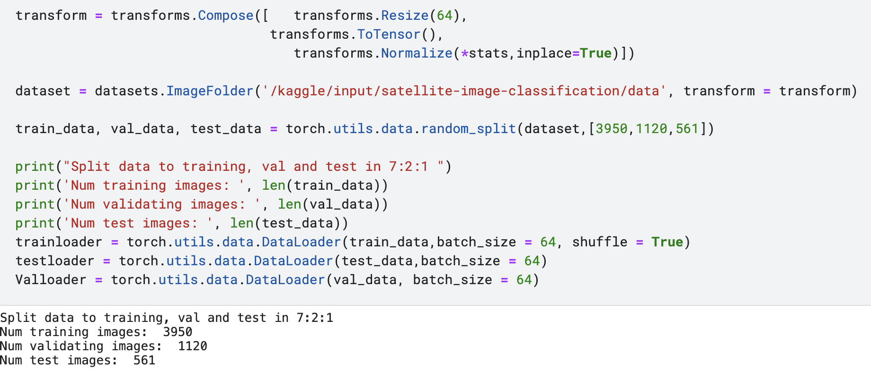
Implementation of MLP
01 Data processing
Import all modules needed
Define transform with known stats
Load dataset with transform
Split data into Training data, Validation data and Testing data in ratio of 7:2:1
Define data loader with batch size of 64
Bar chart of data after splitting

Slide 12
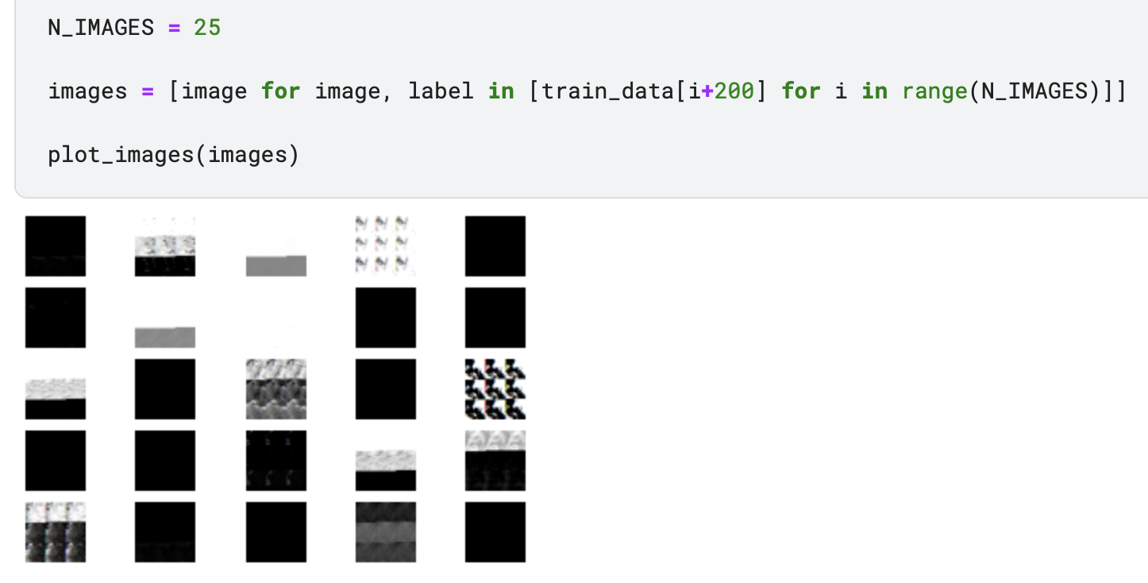
Visualization of Training Data

Slide 13
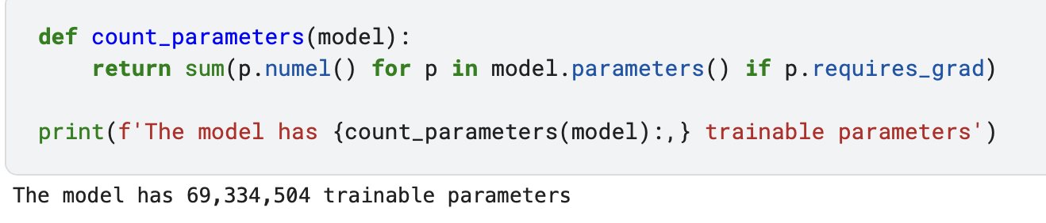
Implementation of MLP
O2 Define Model
Multilayer perceptron (MLP) with four hidden layers.
Input dimension : 64*64*3
Output dimension : 4 (total 4 class for classification)
Hidden Layer 1 : 5000
Hidden Layer 2 : 1500
Hidden Layer 3 : 250
Hidden Layer 4 : 50
Define trainable parameters :

Slide 14
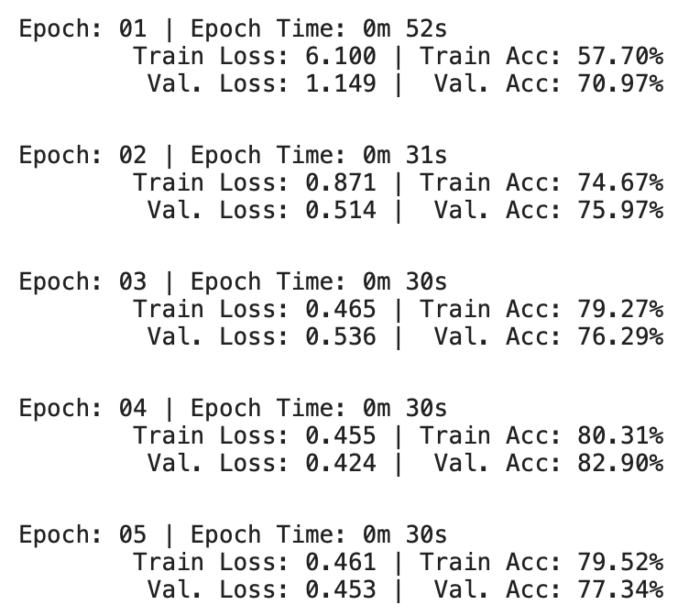
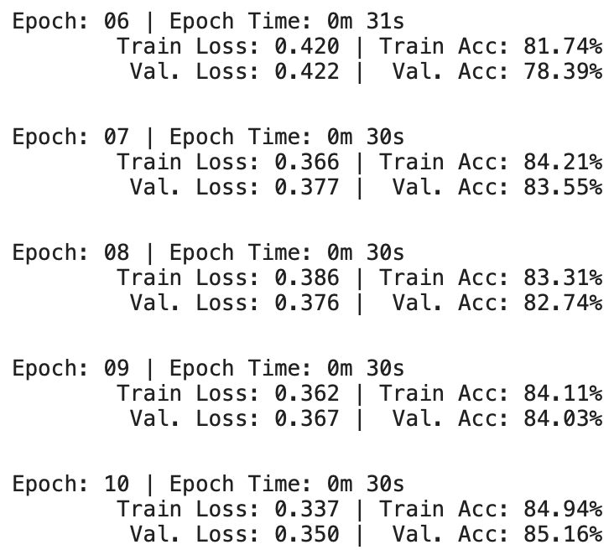
Implementation of MLP
O3 Train and evaluate the model
i) Define Optimizer, Criterion, Device
ii) Define Training Loop & Evaluating Loop
iii) Start Training !

Slide 15
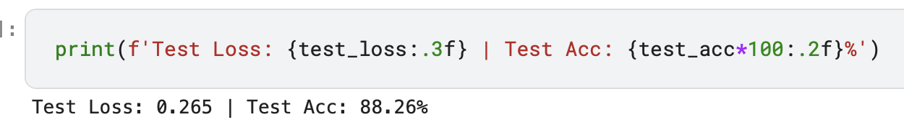
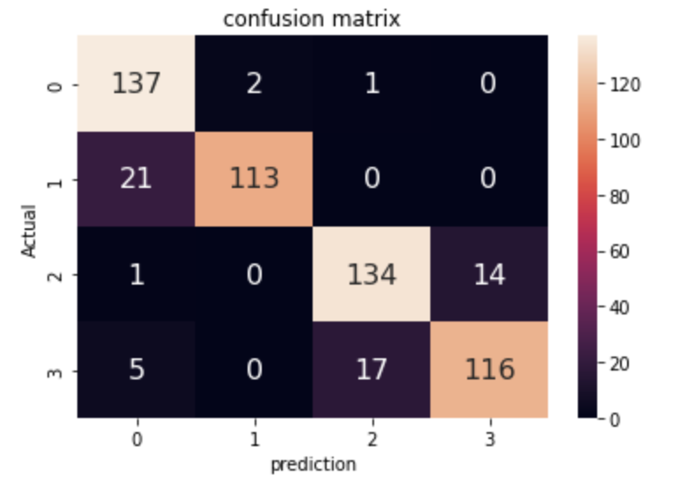
Implementation of MLP
O4 Final result on testing

Slide 16
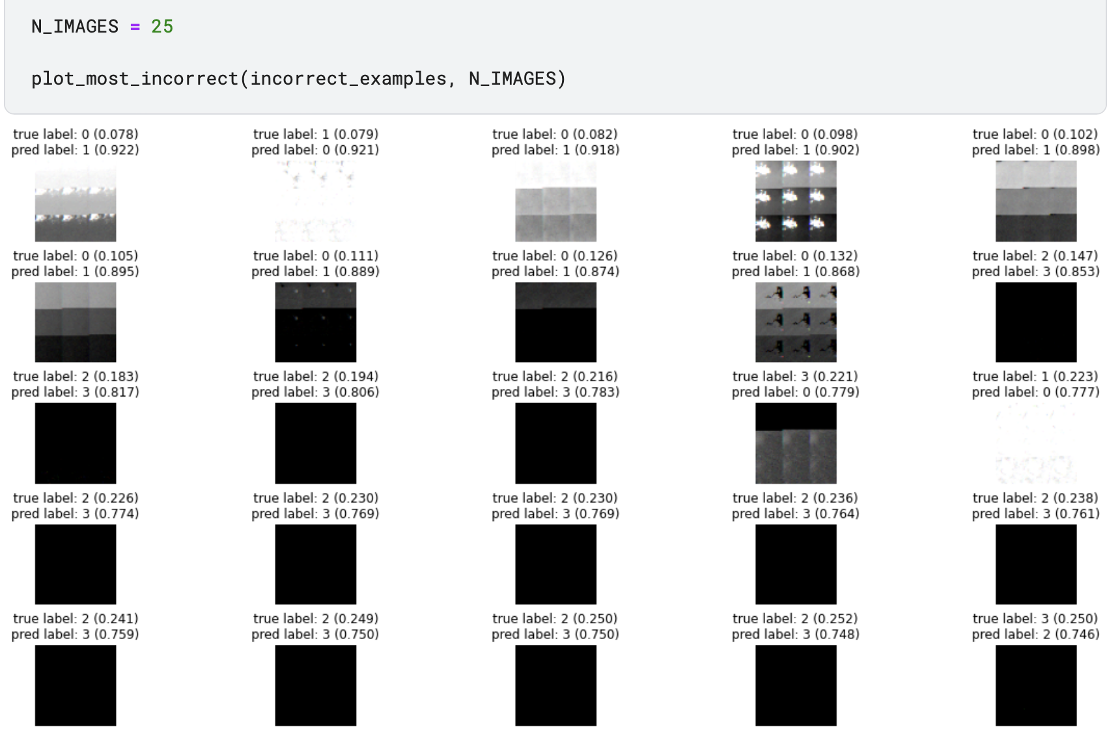
Plot incorrectly predicted label

Slide 17
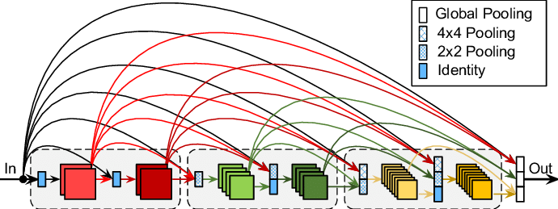
Implementation of DenseNet
What is DenseNet?
Dense Convolutional Network (DenseNet), which connects each layer to every other layer in a feed-forward fashion.

Slide 18
Implementation of DenseNet
01 Data processing
Define transform with known stats
Load dataset with transform
Split data into Training data, Validation data and Testing data in ratio of 7:2:1
Define data loader with batch size of 64
Bar chart of data after splitting

Slide 19
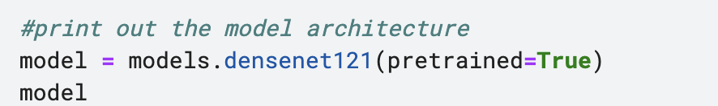
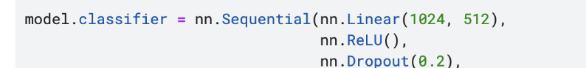
Implementation of DenseNet
O2 Define Model
Model will be a neural network, DenseNet-121. 121 means the depth of each layer in Dense Block.
Using the pytorch.nn module define the neural network using relu activation functions, and softmax.

Slide 20
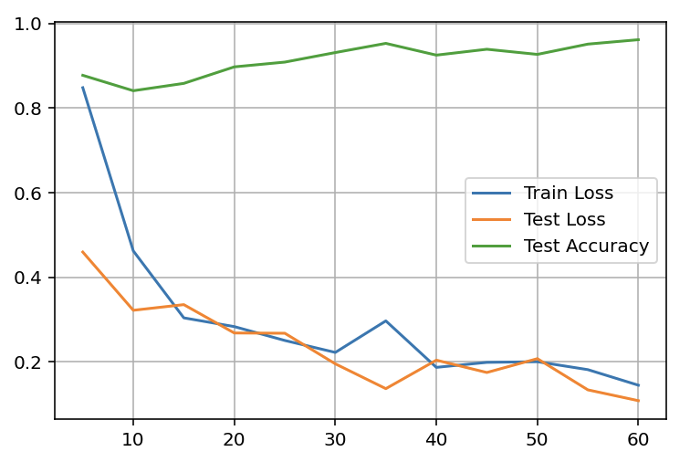
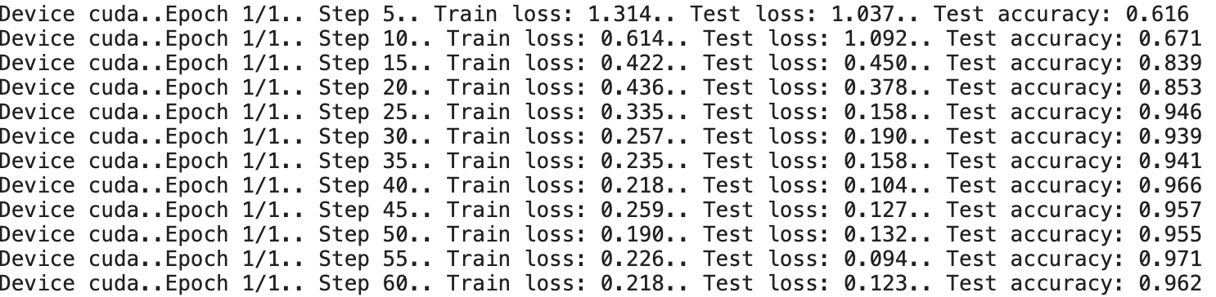
Implementation of DenseNet
O3 Train and evaluate the model
Define the epochs, and inputs to device, then backward propagate and apply optimizer.
calculate the loss calculate the accuracy

Slide 21
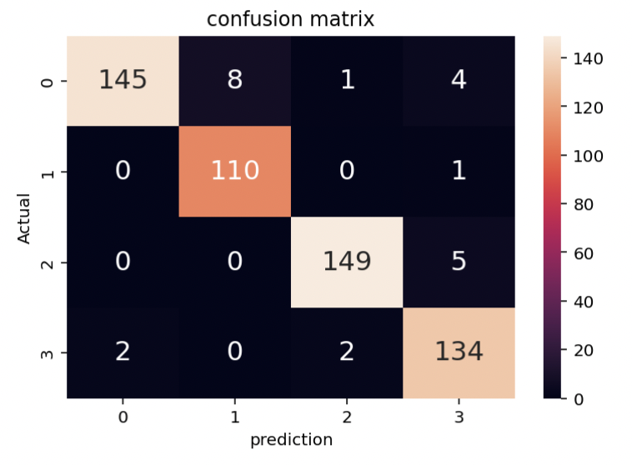
Implementation of DenseNet
O4 Final result on testing

Slide 22
Conclusion
1.
The testing results on MLP is :
2
Error: 0.265 Accuracy: 88.26%
2.
The testing results on DenseNet is:
3
Error: 0.123 Accuracy: 96.2%
1
3.
Conclusion
This project explained the process of predicting a satellite image class with the pytorch library, with a comparison of MLP and a special model DenseNet in CNN.
4
5

Slide 23

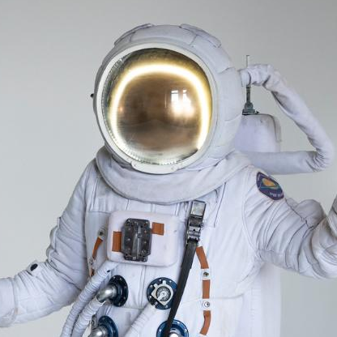
Contribution
Wong Kai Yuan
Guan Jia Xi
DC026157
CC029721
Implementation on MLP
50% of Report
50% of Presentation PPT
Implementation on DenseNet
50% of Report
50% of Presentation PPT
We both work on each part, and integrate together during writing report and PPT.

Slide 24
THANKS!

